Slide 1
SHADOW FAN
Lalit Damodaran
Mrudula Vaidya
Pratyush Bangera

Slide 2
CONTENTS
Introduction
Goals
Construction
Circuits
Working
Problems Solved
Cost Analysis
Future Scope

Slide 3
INTRODUCTION
Standard fans are widely used in personal office spaces.
Typically provided with 2 modes – Static and a Preset swing mode
The first mode requires physical effort for the fan to be directed to the changing position of the user
The second mode can ne wasteful as the fan may be directed to empty spaces due to preset swing.

Slide 4
GOALS
Design an automated fan that follows the user’s movement.
Change the speed of the fan depending on the ambient temperature
In case of more than a single user, provide automated oscillation of the pan, based on their positions.

Slide 5
CONSTRUCTION
Components used:
BASIC STAMP 2 Microcontroller
Parallax Standard Servomotor
PIR ( Passive Infrared) Sensors
Digital Potentiometer (AD5220)
Transistor
Temperature Sensor (DS1620)

Slide 6
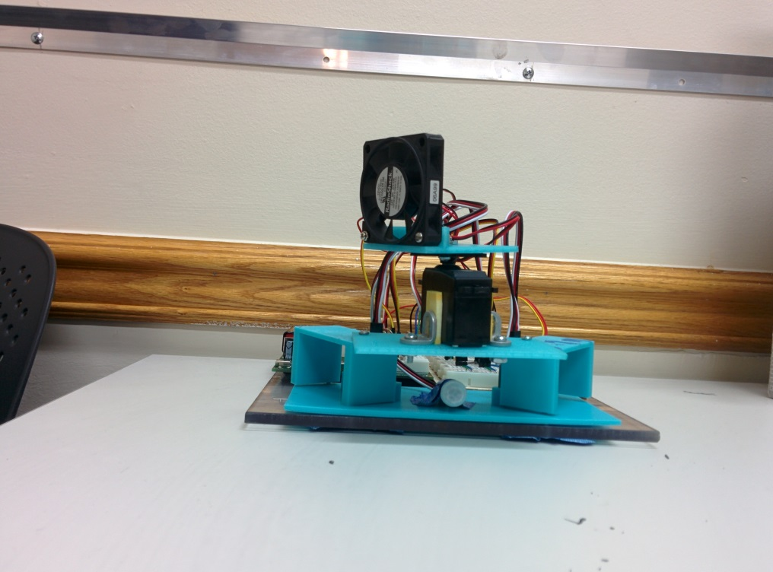
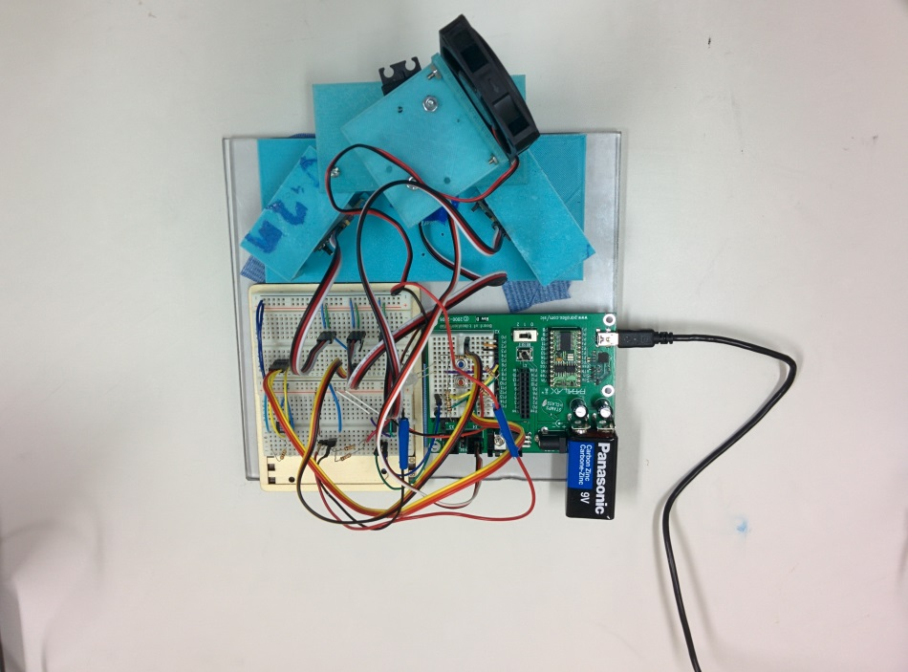

Slide 7
CIRCUIT LAYOUT

Slide 8
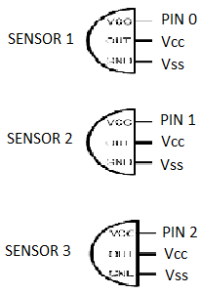
CIRCUITS
PIR (Passive Infrared) Sensor
The PIR sensor will give a HIGH or LOW signal depending on whether it can detect motion or not.

Slide 9
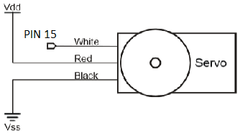
Standard Servomotor
Based on the sensor that detects the motion, the servo head, carrying the fan, is moved to that particular position

Slide 10
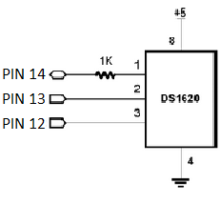
Temperature Sensor (DS1620)
The output of the temperature sensor will indicate the ambient temperature.
The speed of the fan is varied accordingly with respect to the increase or decrease in the temperature.

Slide 11
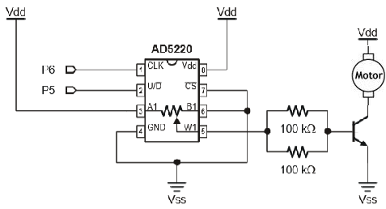
Digital Potentiometer (AD5220)
The potentiometer is used to vary the speed of the fan by varying the resistance
With every degree increase, the potentiometer is varies by 20 steps.

Slide 12
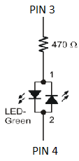
Miscellaneous Circuits
Bicolor LED
Green – Increasing Temperature
Red – Decreasing Temperature
Brushless DC motor (Fan)
The output of the digital potentiometer is used to run the fan and vary the speed depending on the change in temperature

Slide 13
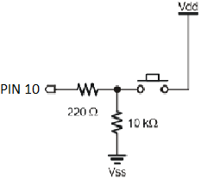
Pushbuttons
Start Switch -
Used to switch the circuit on or to restart the circuit.
Kill Switch-
Used to stops the motion of the servo.

Slide 14
WORKING

Slide 16
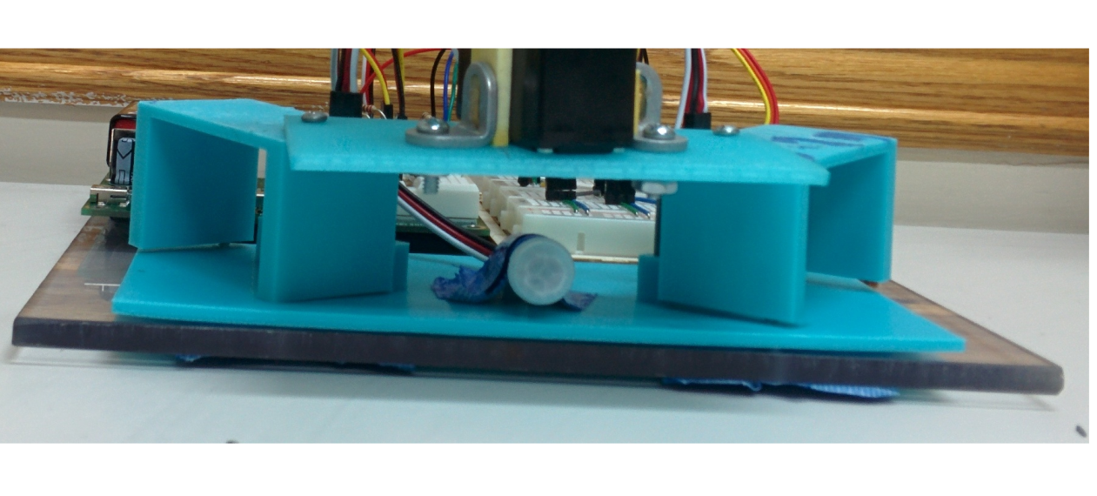
PROBLEMS FACED
Sensor Calibration
Difficulty in positioning the PIR sensors on the board to eliminate superposition of their sensing range
Overcome by designing a mechanical structure separating the three sensors

Slide 17
Temperature sensitivity output
No observable change in fan speed corresponding to varying temperature
Solved by using an LED which shows the incorporation of temperature change on the fan speed

Slide 18
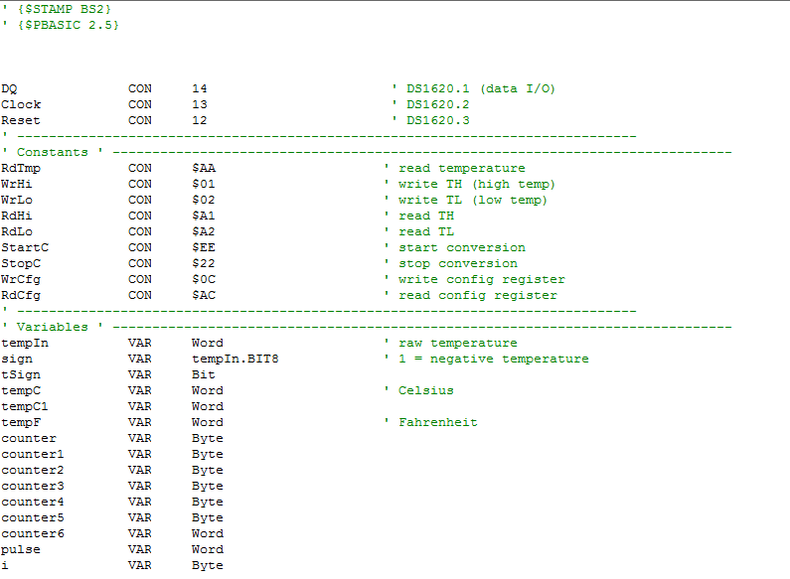
BASIC STAMP CODE

Slide 19
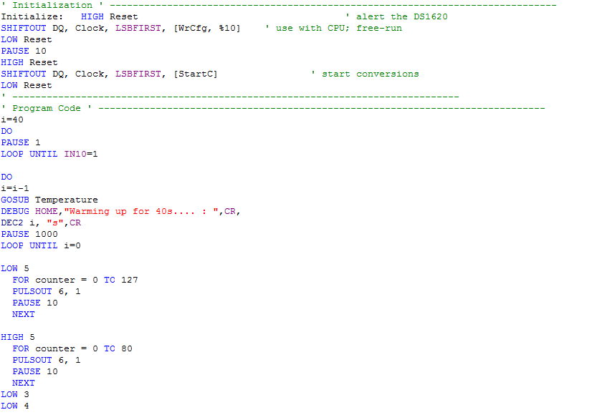

Slide 20
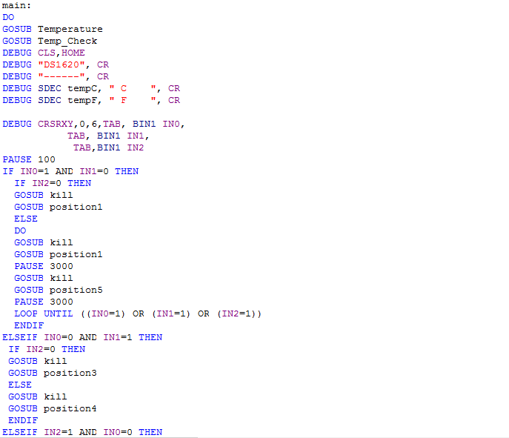
MAIN PROGRAM:

Slide 21
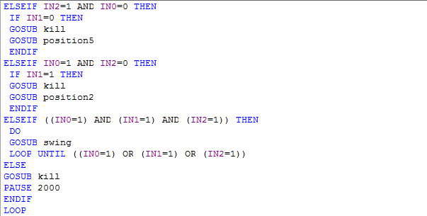

Slide 22
SUBROUTINES:

Slide 23
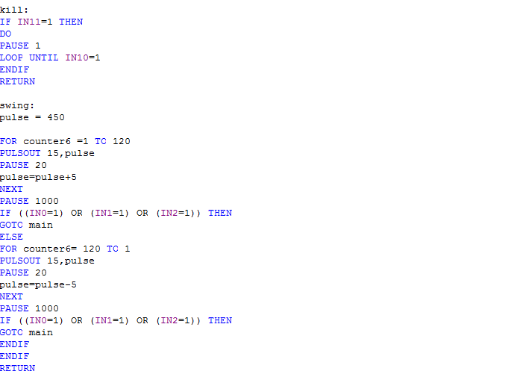

Slide 24
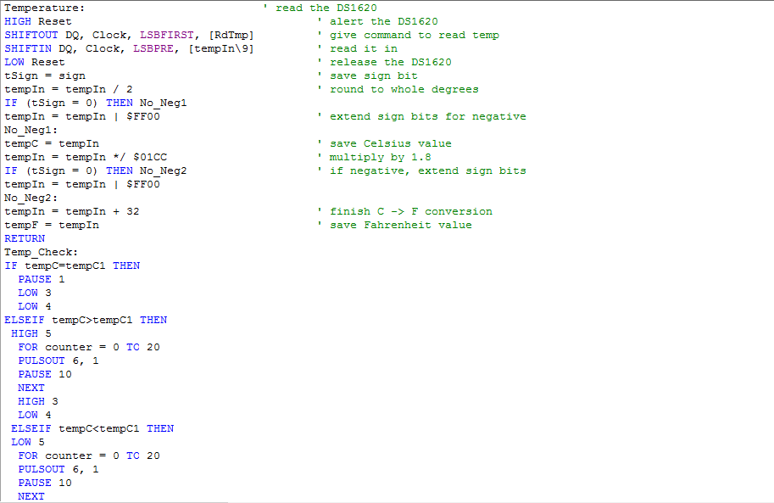

Slide 25
COST ANALYSIS
No. | Component | Quantity | Cost
1. | BASIC STAMP 2 Microcontroller | 1 | $106.00
2. | PIR (Passive Infrared) Sensor | 2 | $20.00
3. | PIR (Passive Infrared) Mini | 1 | $9.00
4. | Standard Parallax Servomotor | 1 | $11.00
5. | RadioShack Microfan | 1 | $10.00
6. | Temperature Sensor (DS1620) | 1 | $5.00
7. | Digital Potentiometer (AD5220) | 1 | $3.00
8. | Misc. (Pushbuttons, Transistor, Resistors, etc.) | - | $3.00
 |  | Total | $167.00
Approximate Mass Production Cost = $70.00

Slide 26
FUTURE SCOPE
Increase the range by incorporating a ${360}^{o}$ field of operation
Increasing the precision by addition of multiple sensors
Integration of the fan into a home automation system

Slide 27
Thank You.

